Slide 1
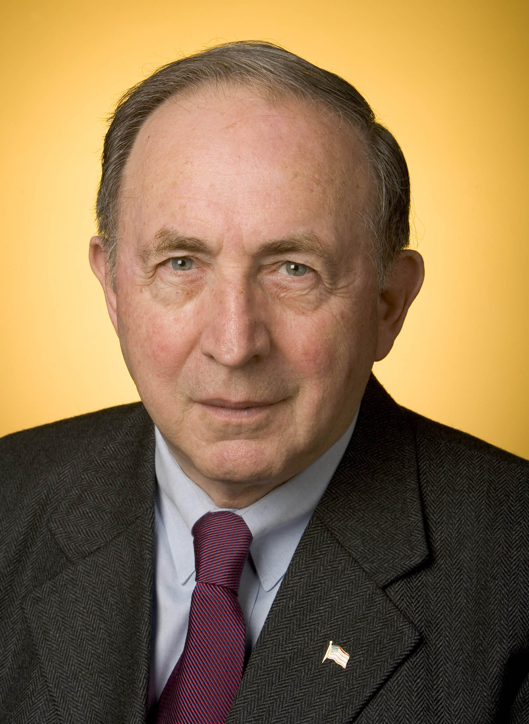
Managing a During a Recession
New Canaan Men’s Club
November 6/2017, Lapham House
Presentation by: Paul A. Strassmann, Investment Club

Slide 2
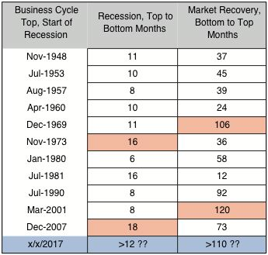
History of 12 Recessions

Slide 3
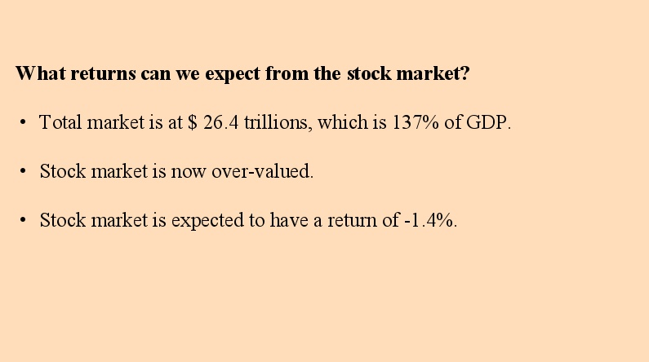

Slide 4
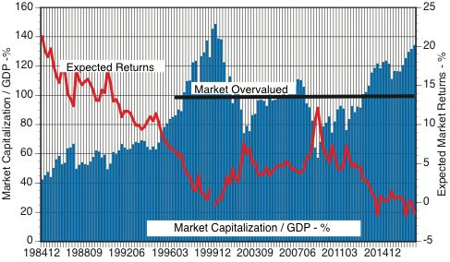
What a Recession Can Do to S&P 500
56%

Slide 5
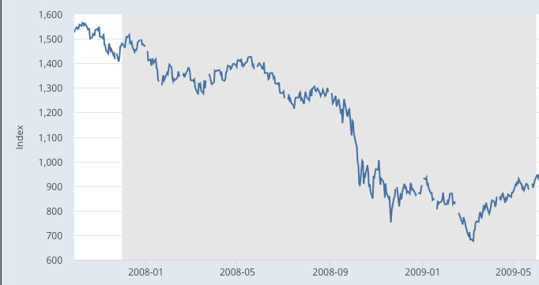

What a Recession Can Do to S&P 500
56%

Slide 6
Expected Recession
Current market recovery over 110 months.
Market recovery reached that much twice in 70 years.
Recession may last more than 12 months.
Plunge in next recession may be very large.

Slide 7
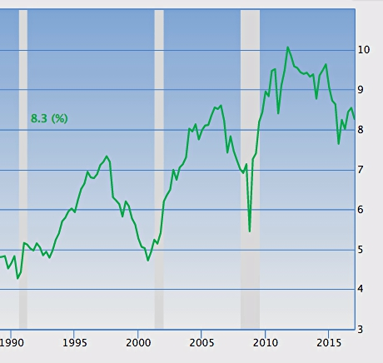
Corporate Profit Margins Are Recession Indicators
http://www.multpl.com/s-p-500-earnings-yield/table/by-year

Slide 8
Why are Corporate Profit Margins Recession Indicators?
Earnings/Investments are the drivers of the stock market.
When corporate profit margins decline to about 5% a recession occurs.
Afterwards the Federal Reserve restores recessions to a prior peak.

Slide 9
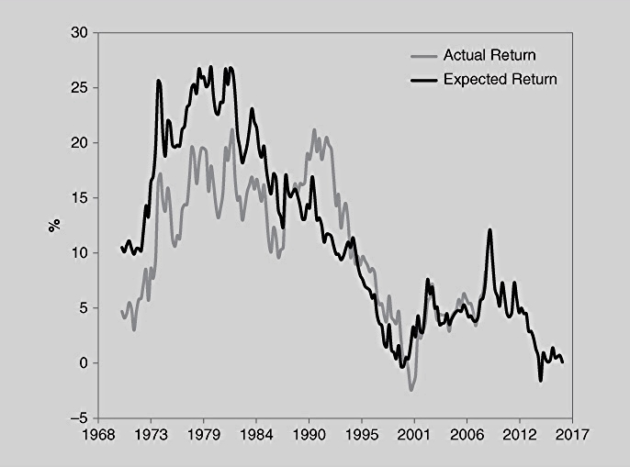
Profit Returns from Investments in US Have Declined
From C.Tiani, Invest Like a Guru, Wiley

Slide 10
Investors Should not Anticipate Past Returns
Annual returns of Wilshire 5000 Full Cap prices have declined.
The US stock market valuations are now in an overall down cycle.
Future market valuations do not look promising.

Slide 11
Added Political Risks to Recession Prospects
Rapid rise in US debt.
Petro dollars now shifting to gold-based China currency.
Cancellation of international treaties.

